Slide 1
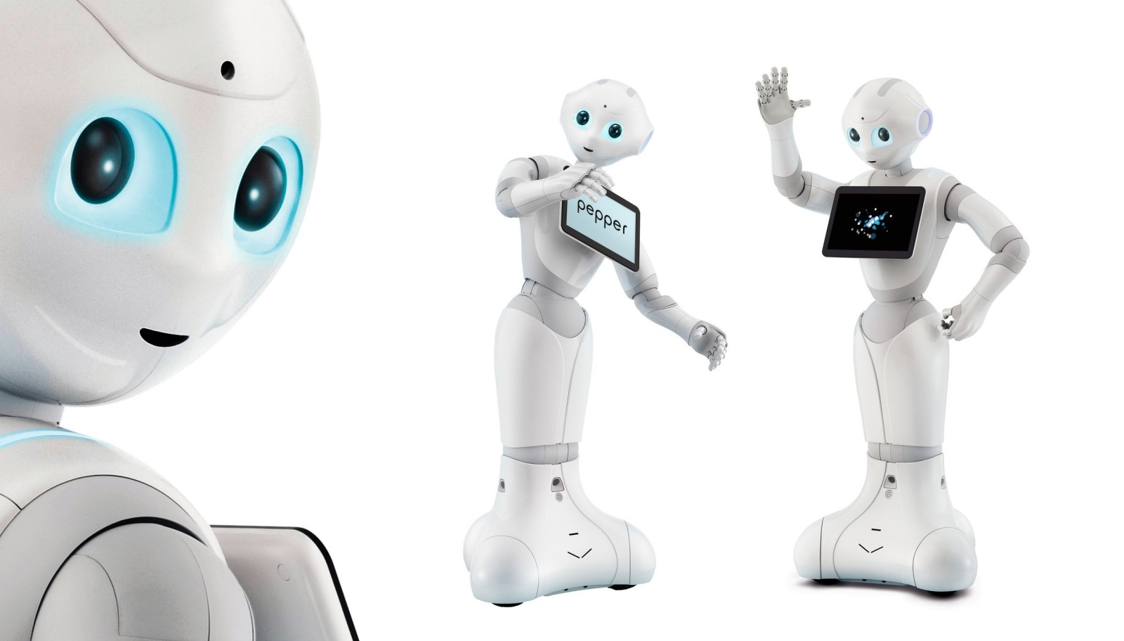
OBJECT DETECTION USING PEPPER

Slide 2
PROJECT OVERVIEW
Loading of the network;
Detection of the object (box, backpack, suitcase, book) from three meters;
Recognition through speech;
Detection of the object from a close distance;
Again recognition.

Slide 3
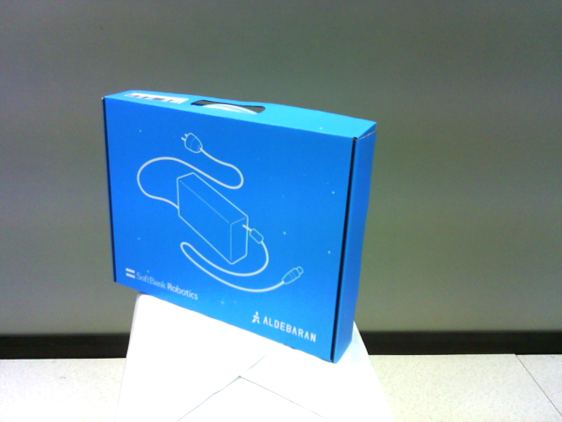
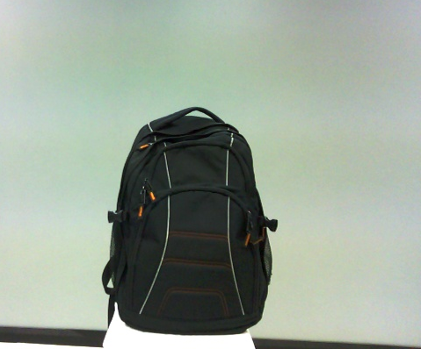
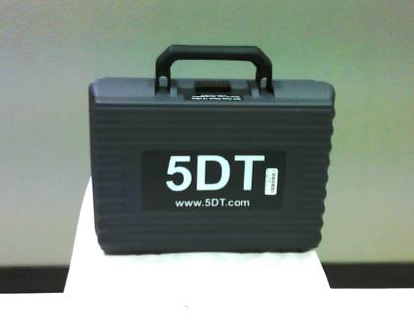
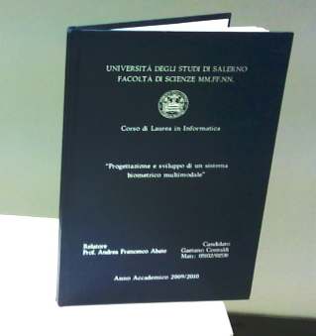
THE DATASET
The backpack
The suitcase
The book
The box

Slide 4




SETTING THE FRAMEWORK
Python 2.7.15
Pepper does not support version 3
Theano and Keras libraries
and many more packages…

Slide 5
THE MODEL
classifier = Sequential()
classifier.add(Conv2D(32, (3, 3), input_shape = (64, 64, 3), activation = 'relu’))
classifier.add(MaxPooling2D(pool_size = (2, 2)))
classifier.add(Conv2D(32, (3, 3), activation = 'relu'))
classifier.add(MaxPooling2D(pool_size = (2, 2)))
classifier.add(Flatten())
classifier.add(Dense(units = 128, activation = 'relu'))
classifier.add(Dense(units = 4, activation = 'softmax'))

Slide 6
COMPILING & TRAINING
classifier.compile(optimizer = 'adam', loss = 'categorical_crossentropy', metrics = ['accuracy’])
classifier.fit_generator(training_set,
steps_per_epoch = 32,
epochs = 128,
validation_data = test_set, validation_steps = 16)

